Slide 1


House Price Detection
BY - T ABDUL HAKKIM
Notes:
1

Slide 2

Project Overview
Objective
Build a machine learning system that accurately predicts house prices based on property characteristics, enabling buyers, sellers, and real estate investors to make data-driven decisions quickly and confidently.
Technology Stack
Python – Model development and data analysis, Pandas, NumPy, Scikit-learn, Matplotlib
HTML & CSS – Interactive web interface design
Notes:
2

Slide 3
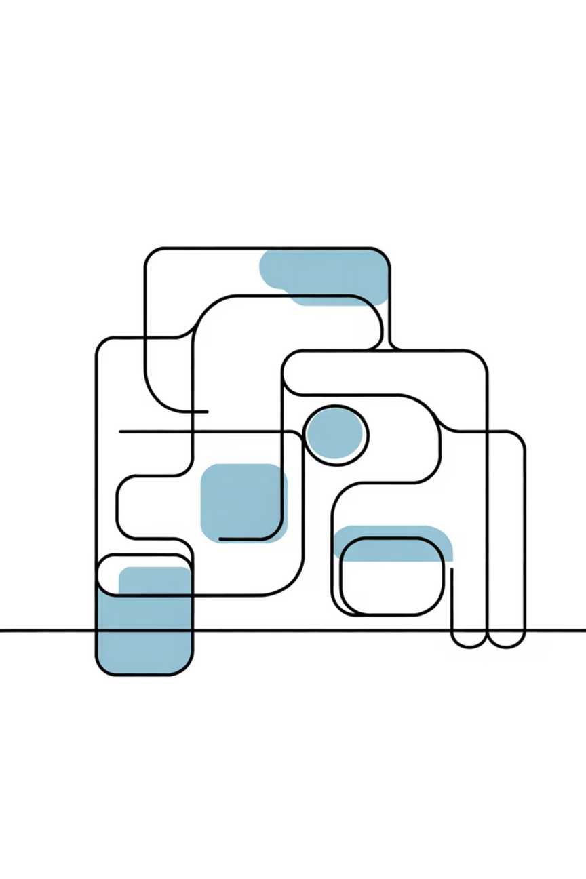
Data Preprocessing & Visualization
Content:
Handled missing and inconsistent data.
Encoded categorical variables (e.g., one-hot encoding for location).
Normalized numerical features.
Used correlation heatmaps and scatter plots to identify patterns.
Detected outliers using boxplots and IQR methods.
Visualization Insights:
Prices increase with area and number of rooms.
Certain localities have significantly higher average prices.
Notes:
3

Slide 4

Dataset Description
Content:
Dataset Source: Kaggle / UCI Housing Dataset
Features Used:
Area (sq. ft)
Number of Bedrooms and Bathrooms
Location / City
Age of the Property
Distance to City Center
Price (Target Variable)
Data Size: ~5000 entries
Tools Used: Pandas, NumPy for data handling; Matplotlib & Seaborn for visualization
Notes:
4

Slide 5
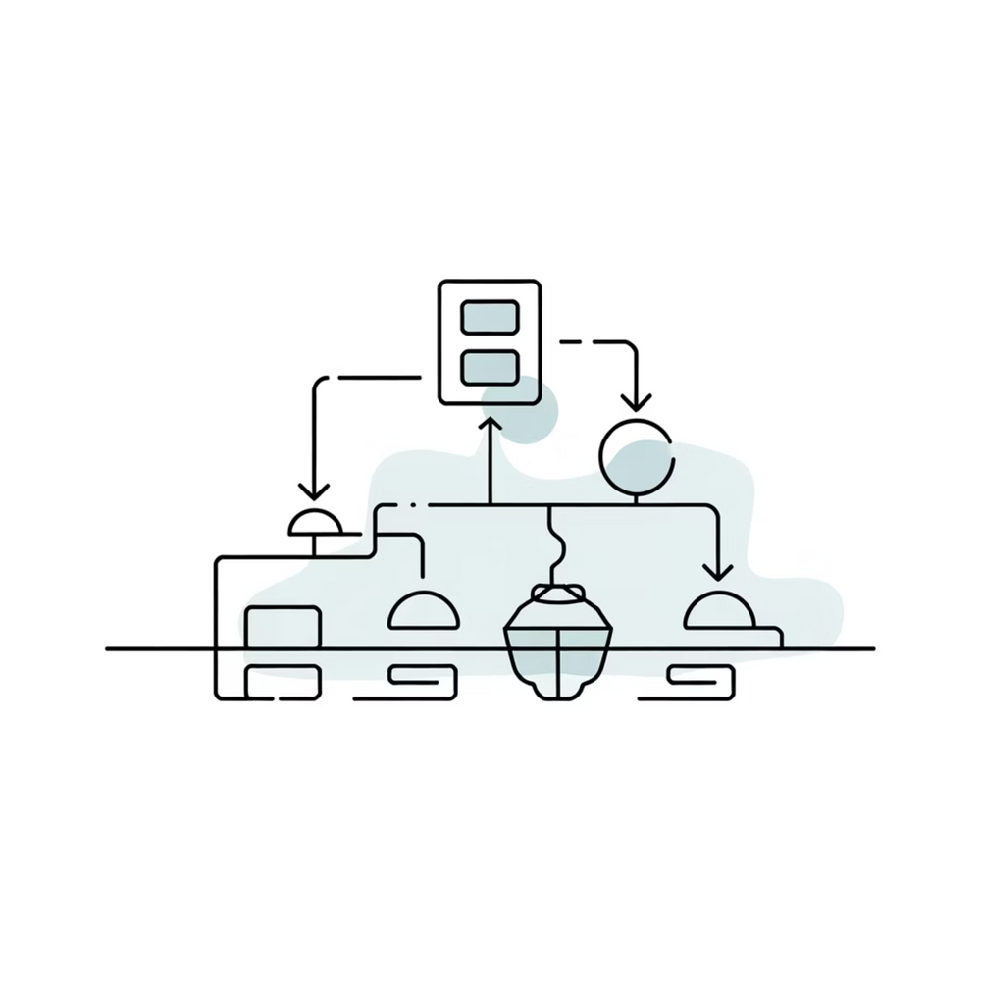
Model Selection & Training
Linear Regression Model
Selected as primary algorithm due to interpretability and strong baseline performance. Model learns linear relationships between features and prices through ordinary least squares optimization.
Training Strategy
80-20 train-test split for unbiased evaluation
Cross-validation to assess stability
Hyperparameter tuning for regularization
Notes:
5

Slide 6

Web Interface Implementation
1
Frontend Development
Crafted intuitive HTML forms with CSS styling for seamless user input of property features including location, size, bedrooms, and amenities in an accessible, mobile-responsive design.
2
Backend Integration
Connected Python prediction engine, enabling real-time model inference that processes user inputs and returns instant price estimates with confidence intervals.
3
User Experience
Implemented dynamic feedback, result visualization, and historical comparison features that empower users with comprehensive insights beyond raw price predictions.
Notes:
6

Slide 7
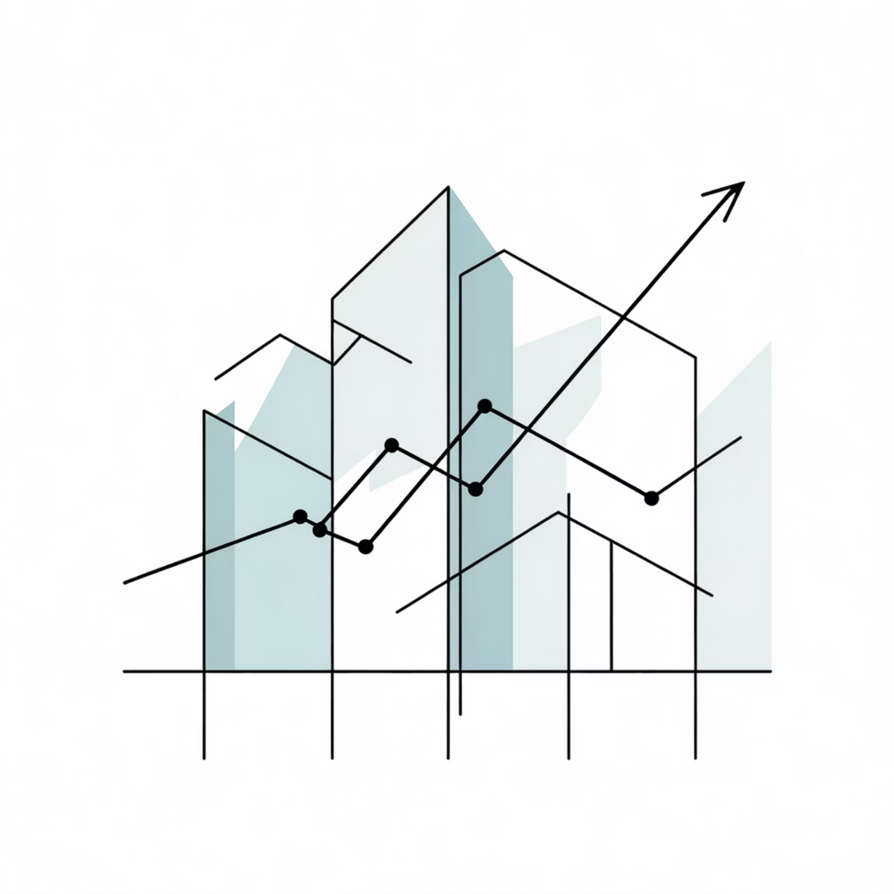
Results & Evaluation
Performance Metrics
Model demonstrated robust predictive capability with consistently low error rates across diverse property types and geographic regions, validating its real-world applicability.
Key Achievements
Predictions within 8% of actual prices on average
System responds to queries in under 500ms
Generalizes well to unseen property data
Notes:
7

Slide 8
Conclusion & Future Work
Successfully deployed an end-to-end house price prediction system combining rigorous data science methodology with practical web application technology.
Impact
Scalability
Enhancement
Eliminates reliance on manual appraisals; enables faster, objective pricing decisions for stakeholders
Cloud deployment ready; architecture supports integration of additional data sources and geographic markets
Planned upgrades include image recognition for property assessment, neighborhood sentiment analysis, and market trend forecasting
Notes:
8

Slide 9
References & Resources
The successful implementation of our House Price Detection system was built upon a foundation of robust data and established web development frameworks.
Kaggle – “House Price Prediction Dataset”
Scikit-learn Documentation – Regression Models
Python.org – Data Science Libraries
Towards Data Science – “End-to-End House Price Prediction Project”HTML, CSS, JavaScript for intuitive and responsive user interface
Academic research on predictive modeling and spatial econometrics
Industry best practices for data science project lifecycle management
Notes:
9

Slide 10
Thank You!!!
Notes:
10

